Slide 1

Your Blockchain Adventure
Or: How You shall learn to Stop Worrying and Love the Blockchain

Slide 2

Why
are You here?
You are curious about Blockchain
You like going on vacation
This Photo by Unknown Author is licensed under CC BY-SA

Slide 3
What does Blockchain and Vacation have in common?

Slide 4

What does Blockchain and Vacation have in common?
What are you talking about?

Slide 5
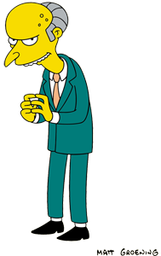
What does Blockchain and Vacation have in common?
We shall use it in our company

Slide 6
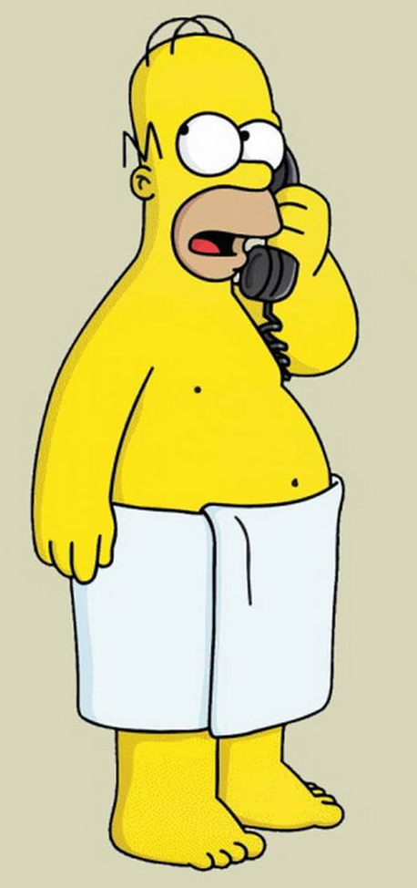
What does Blockchain and Vacation have in common?
You changed my what?

Slide 7
What to expect from today's session
When and why to use a Blockchain
How Blockchain works with Microsoft PowerPlatform

Slide 8
Ledger
What is a Blockchain?
Distributed
Immutable
Trust

Slide 9

Decentralised finance
Fair trading
Auditing
Cryptocurrency
Supply chain monitoring
Digital Ids
Digital Voting
Intellectual Property rights
Tax regulation
Weapons tracking
Medical Record keeping
Real estate transfer
Loyalty cards
Vacation request
…………place your idea here
I have 3 million reasons to use a Blockchain. Try and find them all!

Slide 10
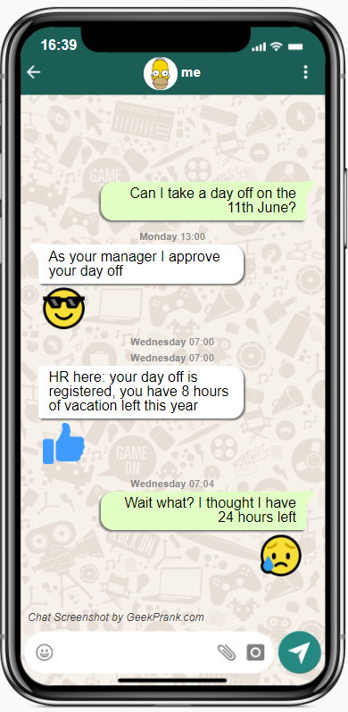
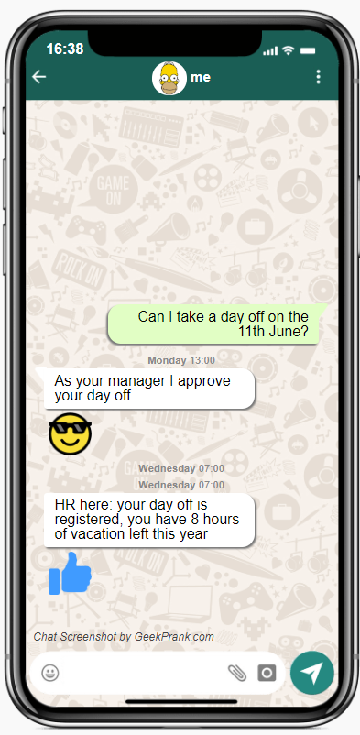
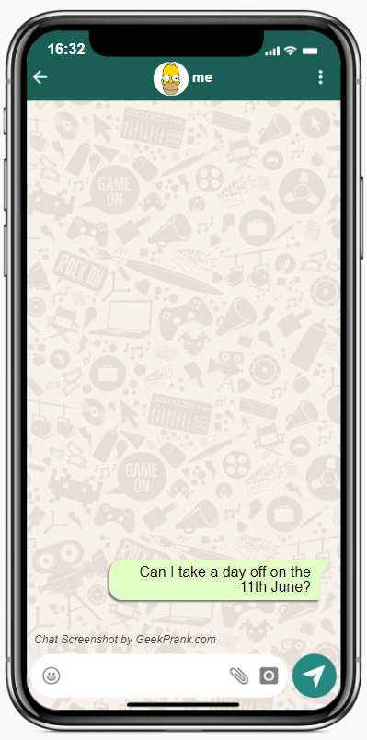
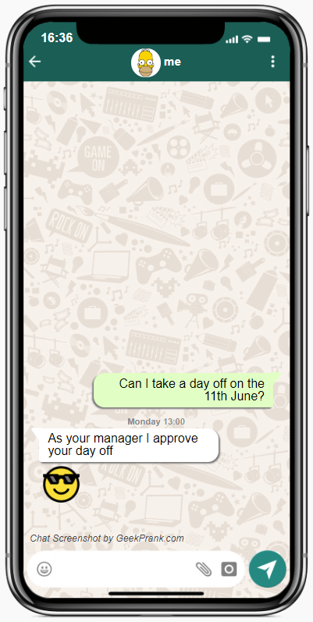
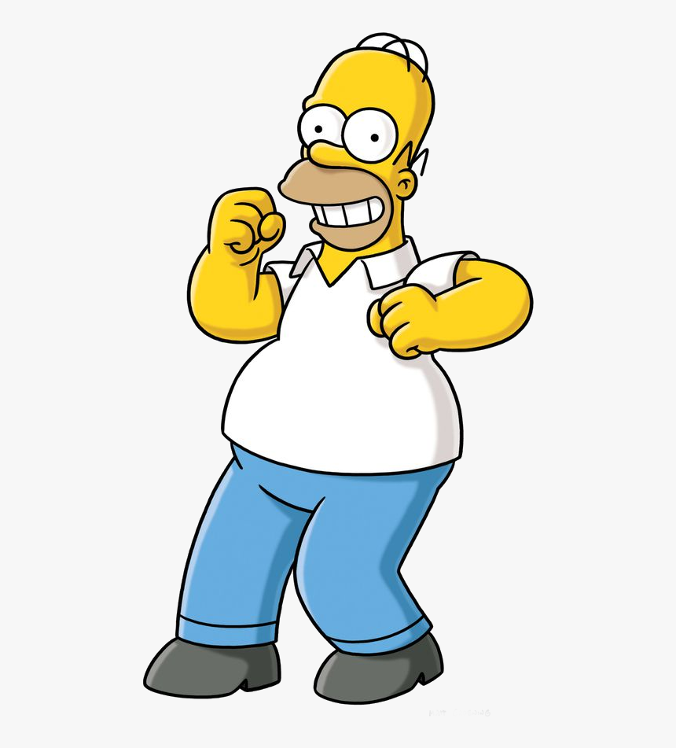
Time for holidays!

Slide 11
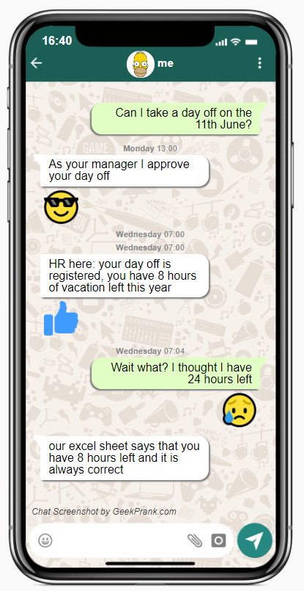


Slide 12
Where does the Traditional process fail?
Central Authority – can I trust it?
Central Store – is it secure?
Multiple copies –
What if I don’t agree?

Slide 13
Who owns your holiday hours?

Slide 14



How much are your holiday hours worth?

Slide 15
Would you trust a stranger with your money and no accountability?

Slide 16
Would you trust a stranger with your money and no accountability?
You need a Contract

Slide 17

Modern process – VAC token

Slide 18
What’s new with the modern process?
Holidays are truly yours
Single point of truth
Many witnesses

Slide 19
PowerApp

Slide 20
Blockchain explorer

Slide 21
Infrastructure

Slide 22
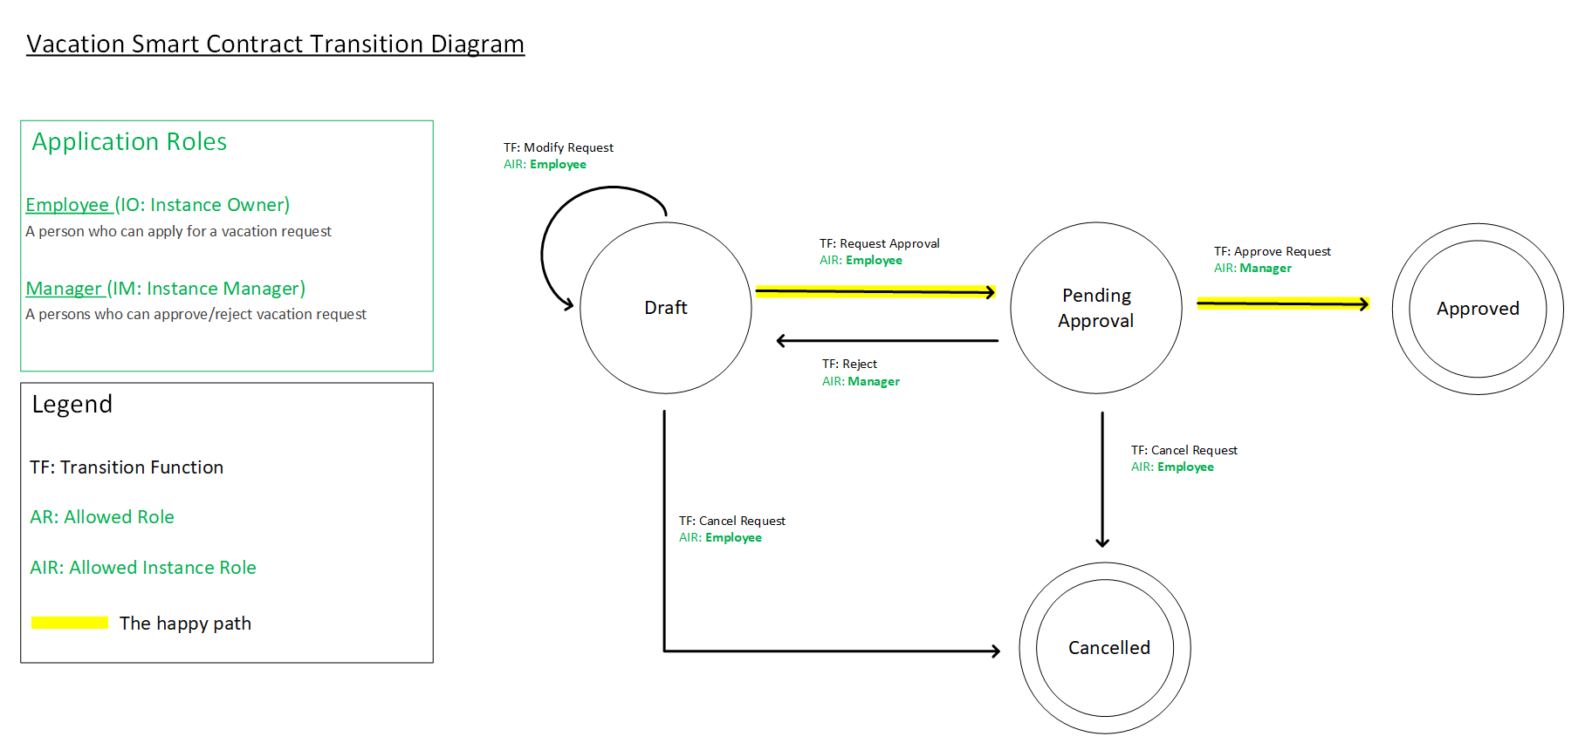
The contract

Slide 23
How the Powerapp was built (connector, ABI, network)

Slide 24
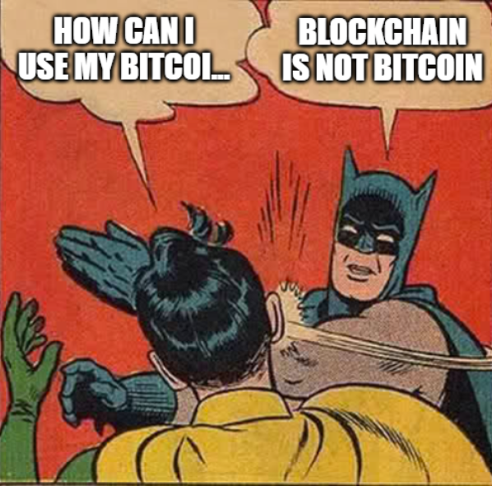
Any Questions?

Slide 25
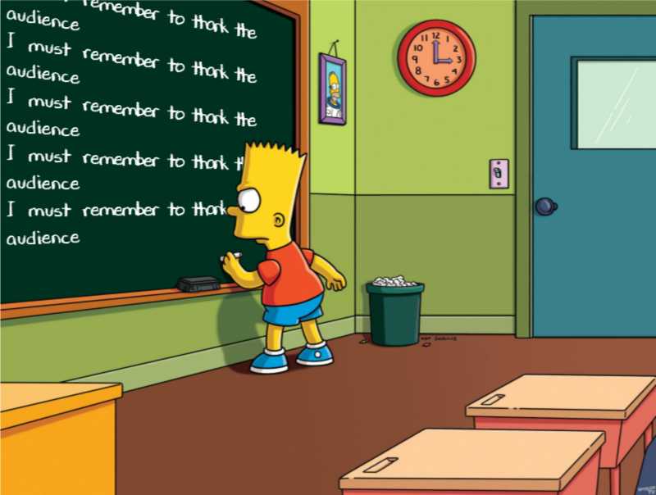

Slide 26
Links/References

